Slide 1
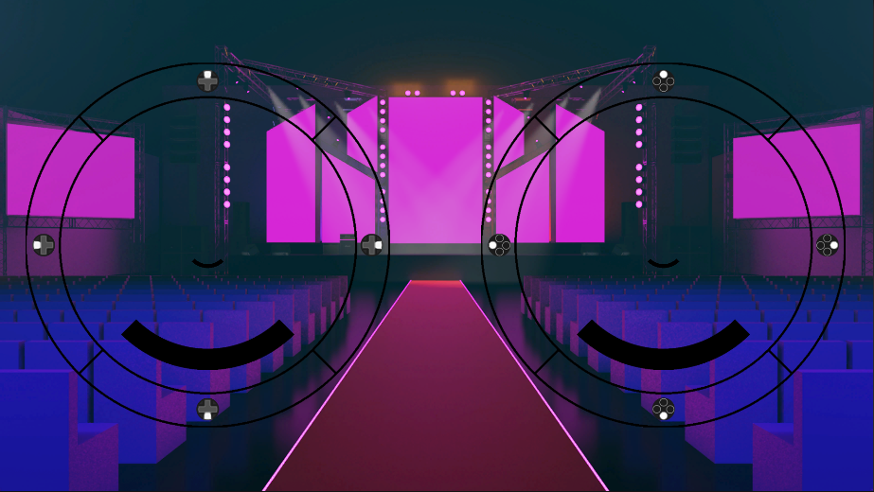
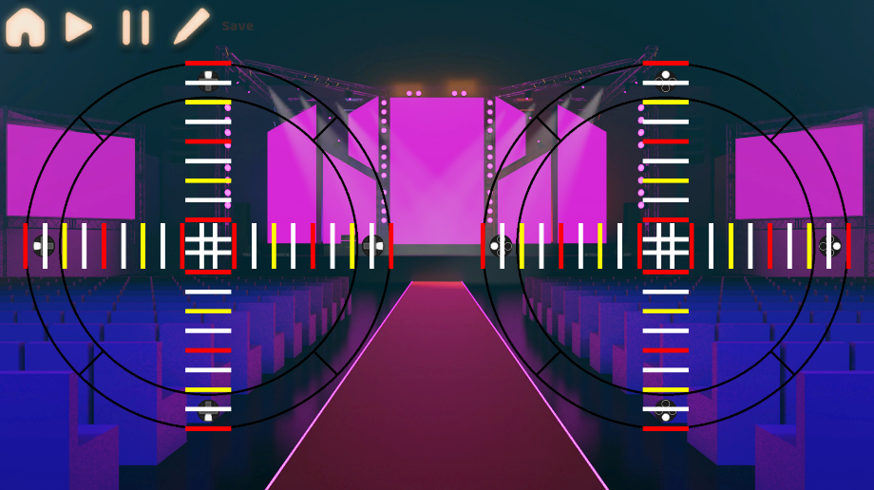

Rhythmix
Precise controller gameplay where you have to time your hits to the music
Create your own levels using the in-game level editor where you can even add your own music
Theo Butler
theo.butler@students.plymouth.ac.uk
BSc (Hons) Computer Science (Game Development)

